Slide 1

DriverPass System Analysis
Dawneen Graham
Notes:
[No speaker notes required for this slide.]

Slide 2

System Requirements
Functional Requirements
The system will follow all compliance regulations and will allow updates from the DMV.
The system will allow users to log in when they give correct password and user ID.
Non-Functional Requirements
Will need cloud storage for website and database data.
Users shall be able to reset their passwords after 5 failed log in attempts.
Notes:
DriverPass will have several requirements in order to function as desired. For the functional requirements, system will need to be able to connect to DMV for updates for latest policies. Users should also be able to create and modify an account. They should have ability to work out of modules, check grades, book appointments/schedule tests, or real-time driving with an instructor. Some examples of Non-Functional requirements would be the need for a storage system to save user data, module, grades. User should also be able to reset password after 5 attempts. If several faulty attempts, alert should be sent to admin and account should be locked.

Slide 3
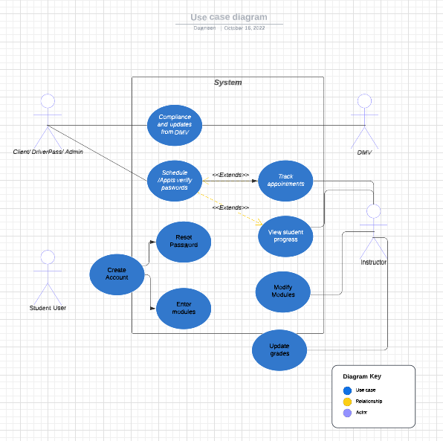
Use Case Diagram
[Insert your use case diagram here.]
Notes:
The different actors in my Use Case Diagram are Admin/ IT/ Client (which would normally have their own actor, but I could only create so many w/o having premium. Our client, DriverPass, Admin, and IT would be able to change passwords or be alerted if account was locked due to more than 5 incorrect attempts. Our student could log into modules, schedule driving appointments, and view grades after they created an account. They could reset the password. Our instructor can update grades, adjust modules, track student progress, and view driver schedule. The system would also be updated any time that the DMV had changes in policy.

Slide 4
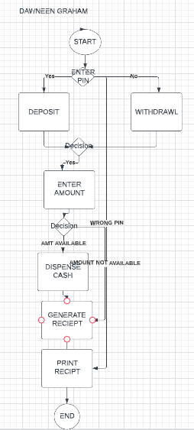
Activity Diagram
Notes:
The UML Activity Diagram shows the user verifying their pin, if the pin is wrong, it ends the program. If the pin entered is correct, it asks for an amount which the person wants to deposit or withdraw. If the amount is not available, a receipt is generating, if it is, cash is dispensed before receipt is generated and printed.

Slide 5
Security
Users must authenticate their email address.
Users are to use a secure password that meets certain criteria in order to log-in.
After 5 failed attempts, admin is alerted, and account is locked.
Brute force attempts are halted, and admin alerted.
Information is sent via HTTPS and is encrypted.
Notes:
There are several security features that could be put in place. Users first step would be to log in- in doing so, they would validate their email address and their secure password. This password, would be required to be reset every 120 days. After 5 failed attempts admin is alerted and account is locked. Brute force attempts are halted so that hackers can not infiltrate the user's account. Lastly, the need for information to be encrypted using a HTTPS would be a preventive measure.

Slide 6
System Limitations
Assuming everyone has access to the internet, and broadband that can access modules.
That users will have a device that can access the materials.
The timeline is limiting for creating a system that would have all the functionality that DriverPass would like.
The budget for all system desires is not mentioned which may limit what can be accomplished.
Notes:
Some users may not have access to internet, or to reliable internet. The user may not have access to a device that is capable of working well with Microsoft windows- such as a mac. The timeline may make it difficult to complete all desired functionality. The budget is not mentioned, do we have on staff-engineers who can modify as updates are needed or will they need to be sourced? May also limit the ability to accomplish all desires of the client.

